Slide 1
Homework 2A
2021315385
이건 / Gun Daniel Lee

Slide 2
Problem explanation
Calculate the scores of 20 soccer teams and sort in descending order
Given inputs are:
A: points given for a Win
B: points given for a Tie
A 20 by 20 matrix where the results are represented as “W” (win), “T” (tie), “L” (lose), and “X” (disregarded)

Slide 3
Solution explanation
Using a nested for loop, calculate the scores of the 20 teams
After calculating each team’s score, check whether the new team’s score needs to be sorted (meaning it is greater than the previous team’s score)
If sorting is needed, use a while loop to sort before calculating the next team’s score

Slide 4
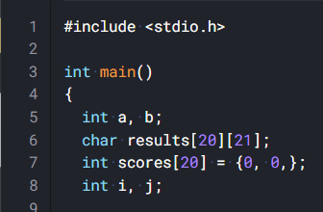
Solution explanation
A: points for a win
B: points for a tie
Results: The league result matrix
(20 by 21 for the null character
since input is received as a string)
Scores: sorted array of the scores
i, j: iteration variables

Slide 5
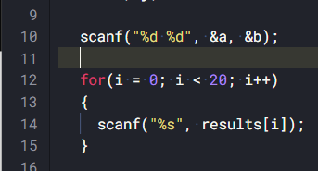
Solution explanation
Scan for A and B
Use a for loop to scan for the results

Slide 6
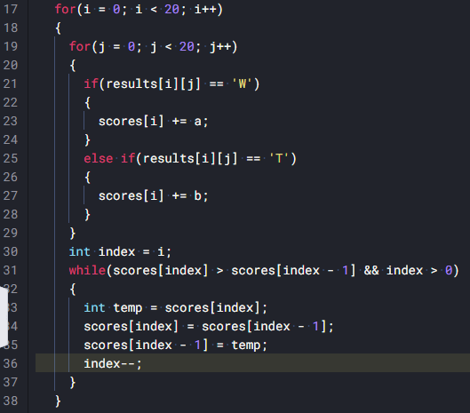
Solution explanation
Nested for loop for calculating
and sorting

Slide 7
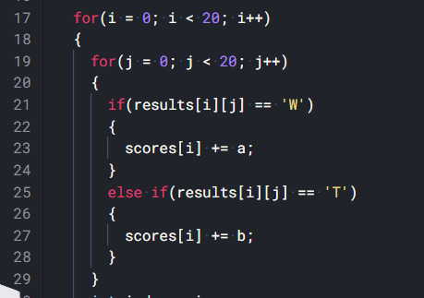
Solution explanation
Nested for loop for calculating
and sorting
Part 1: Calculating
For all the results in results[ i ], add
the score into scores[ i ]
Add A if it’s a win and B if it’s a tie

Slide 8
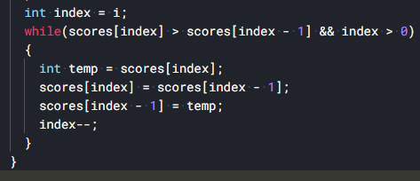
Solution explanation
Nested for loop for calculating
and sorting
Part 2: Sorting
Condition: current score is
greater than previous score
and current score is not the
first score
Use while loop to keep
swapping if condition is true

Slide 9
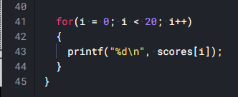
Solution explanation
Print results using for loop

Slide 10
Solution analysis
Main Idea was to reduce the sorting process by eliminating already sorted scores
Favorable inputs:
The results are already sorted in descending order

Slide 11
Thank you!

